Slide 1
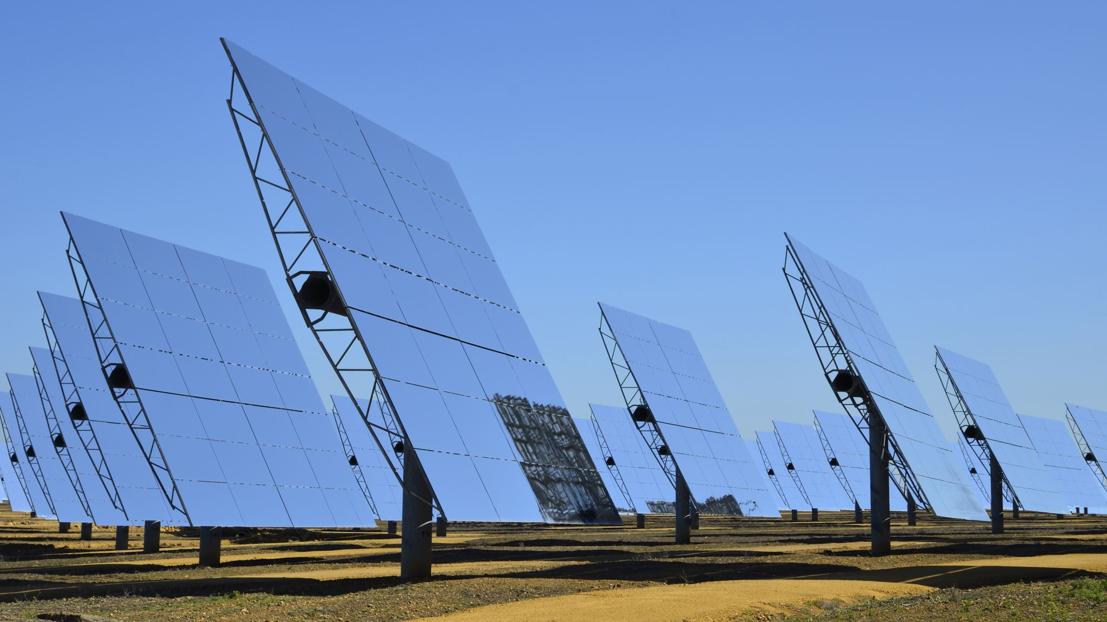
SOLAR PANEL MANAGEMENT SYSTEM
YEOW YU LEONG
TP062373
ASSOC. PROF. DR. LAI NAI SHYAN

Slide 2
Table of contents
RESEARCH PROBLEMS
AIM AND OBJECTIVES
LITERATURE REVIEW
SYSTEM IMPLEMENTATION
SIMULINK RESULTS
MACHINE LEARNING-WEATHER PREDICTION
TEST 1-5
CONCLUSION
REFERENCES

Slide 3
Research problems
MPPT
Higher oscillation in steady state.
Step size bigger, not accurate
In consistent duty cycle.
BMS
1) Not many external BMS in the market
2) No communication within BMS and batteries.
3) No integrated weather prediction system.

Slide 4
Aim and objectives
Aim: To optimize battery charging in solar systems through the development of Perturb and Observe algorithm for Maximum Power Point Tracking (MPPT) integrated with a Battery Management System (BMS).
Objectives:
To develop an enhanced P&O algorithm for MPPT optimization using MATLAB Simulink PV system.
To develop a forecasting system for the BMS utilizing machine learning algorithms for future energy demand predictions.
To evaluate the performance of the integrated MPPT and BMS in term of sensitivity, accuracy, consistency, and power consumption.

Slide 5
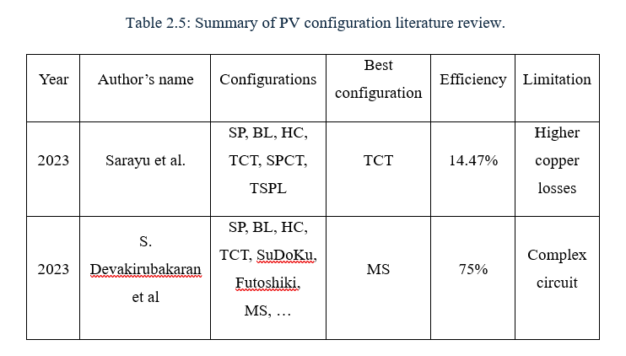
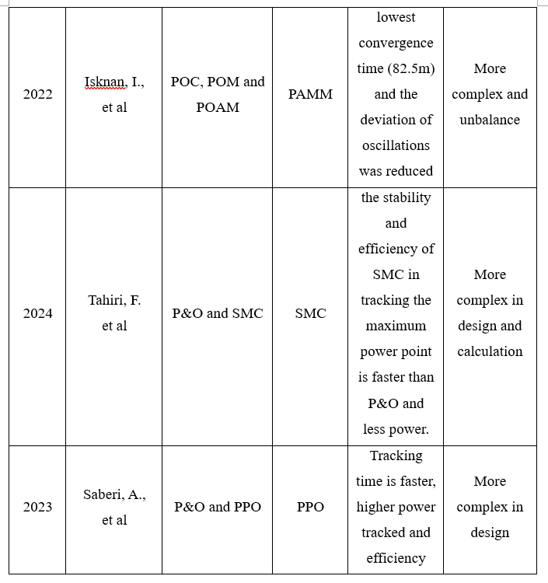
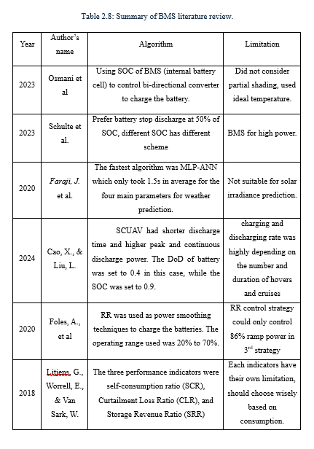
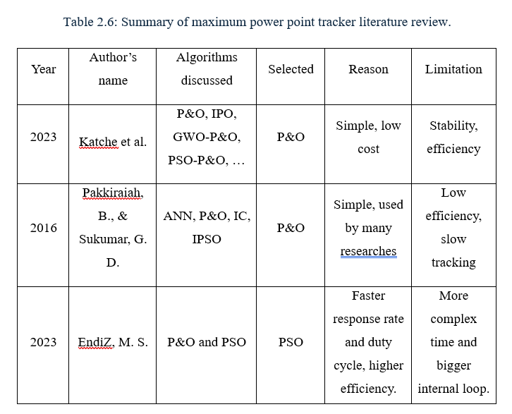
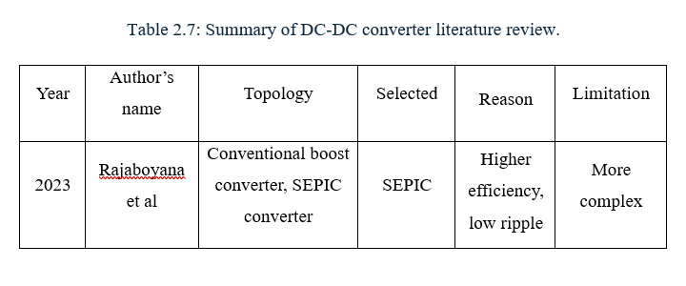
Literature review

Slide 6
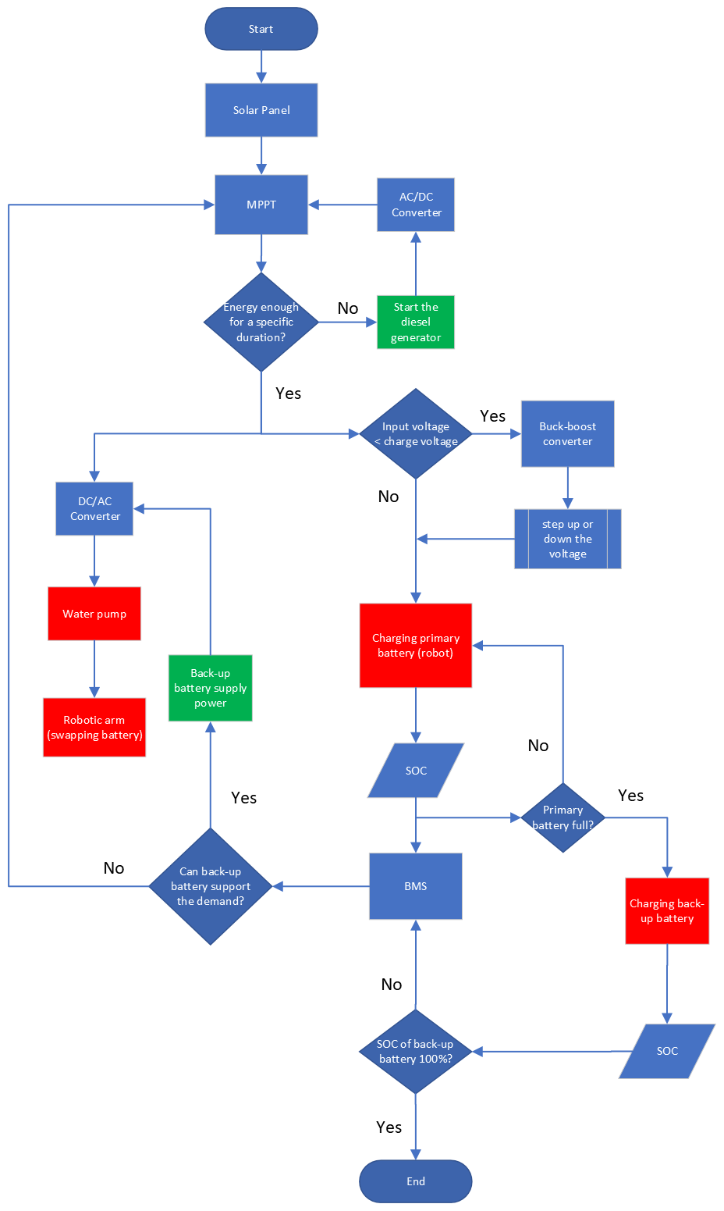
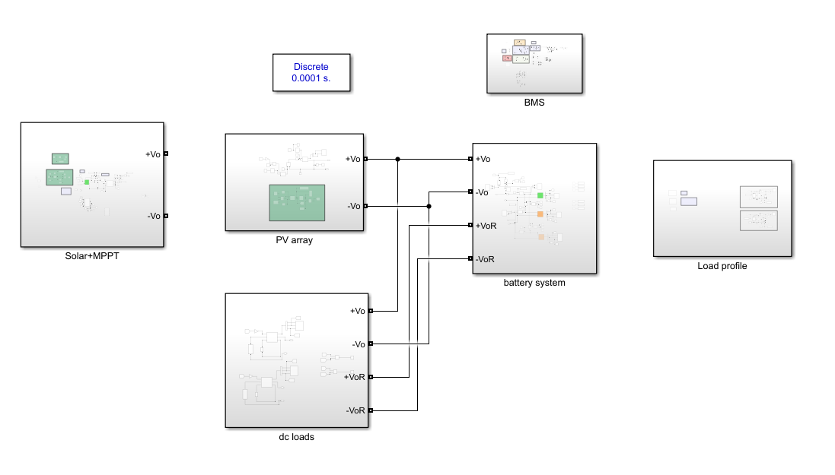
System implementation

Slide 7
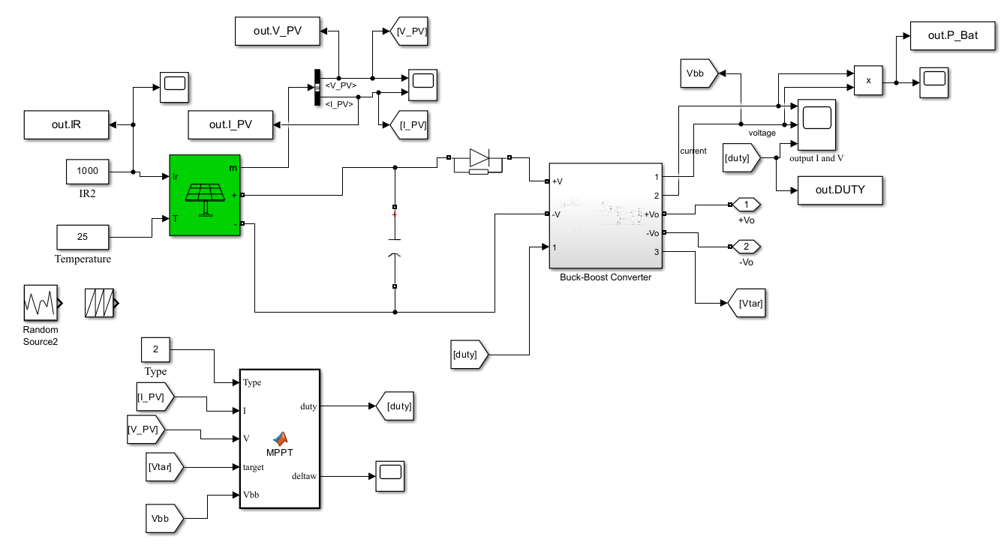
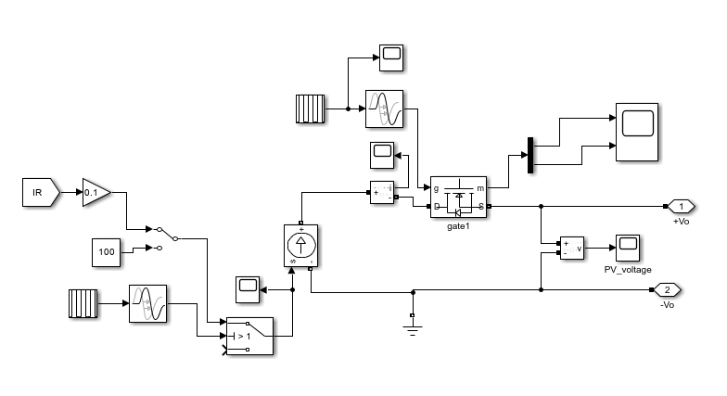
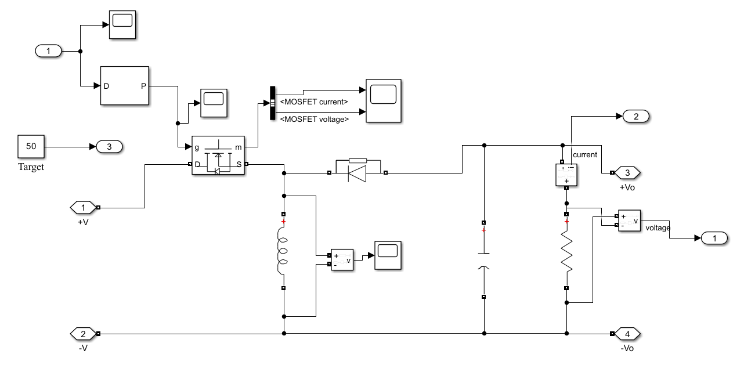

Slide 8
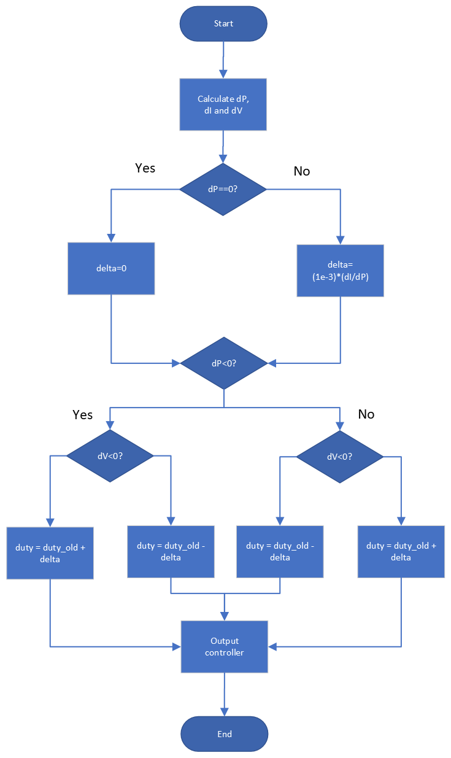
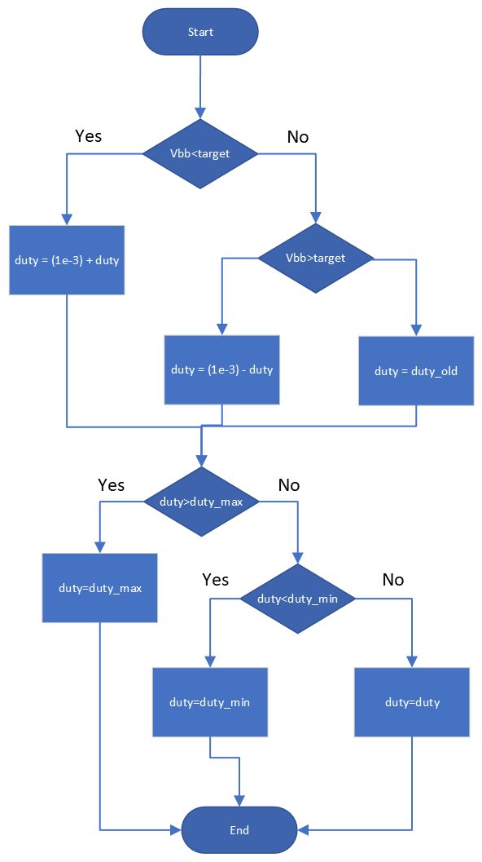

Slide 9
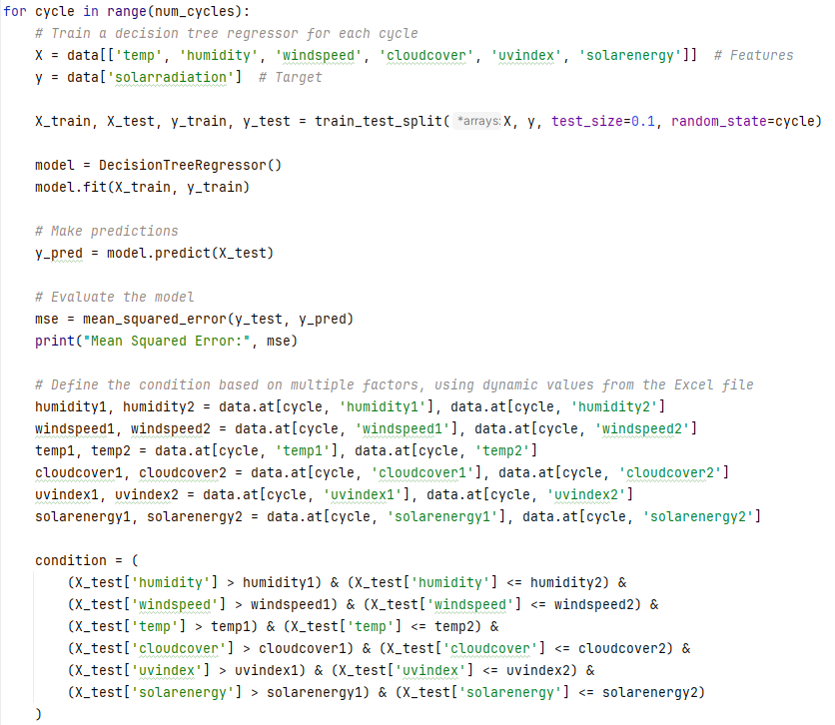
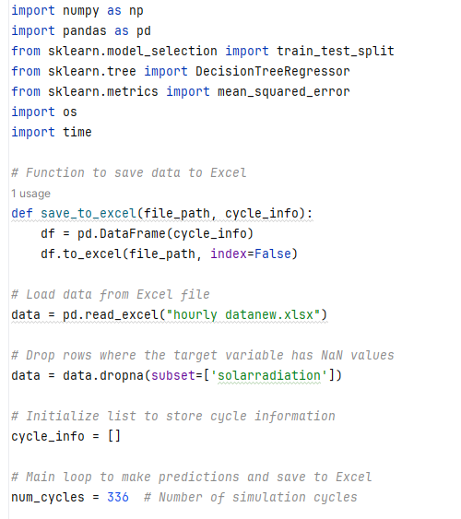

Slide 10
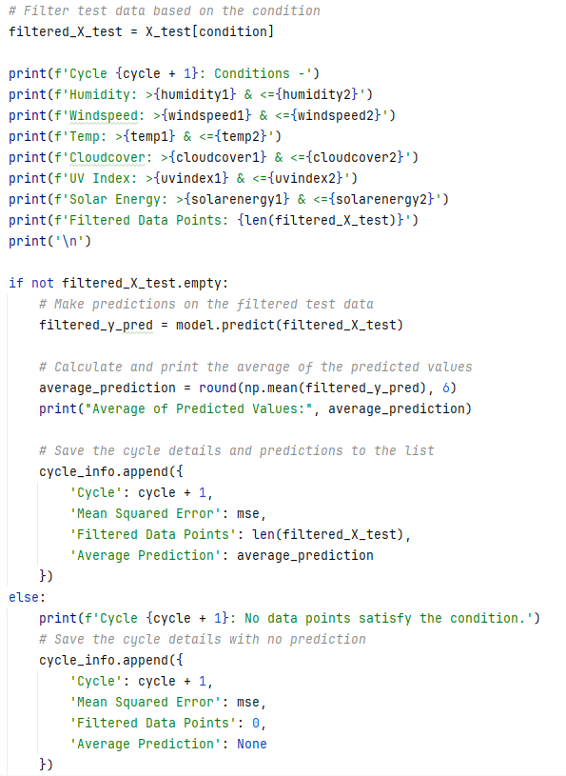
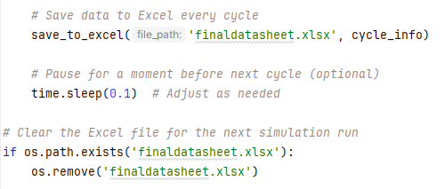
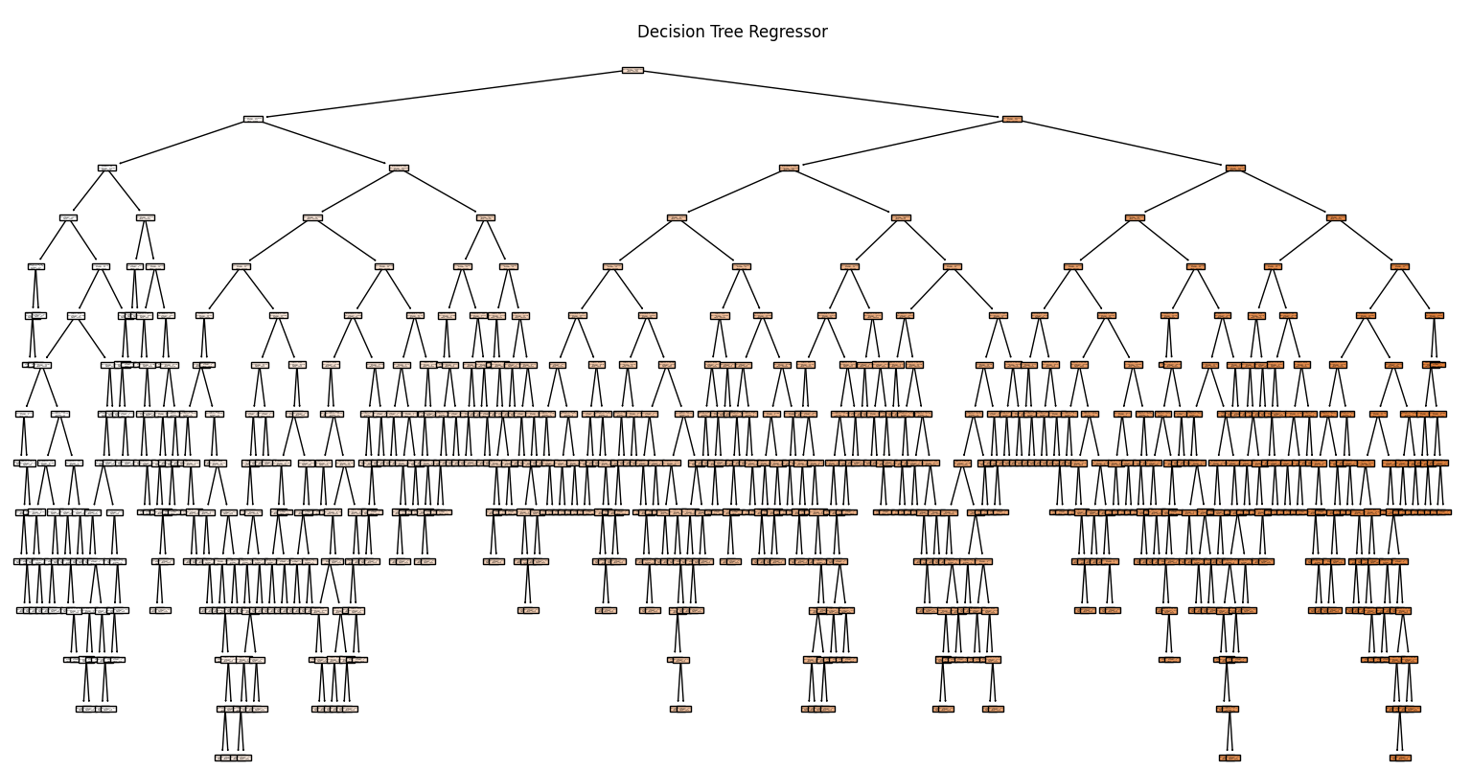

Slide 11
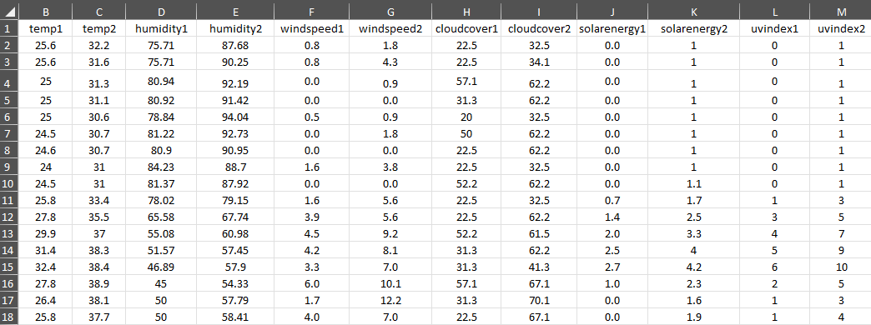
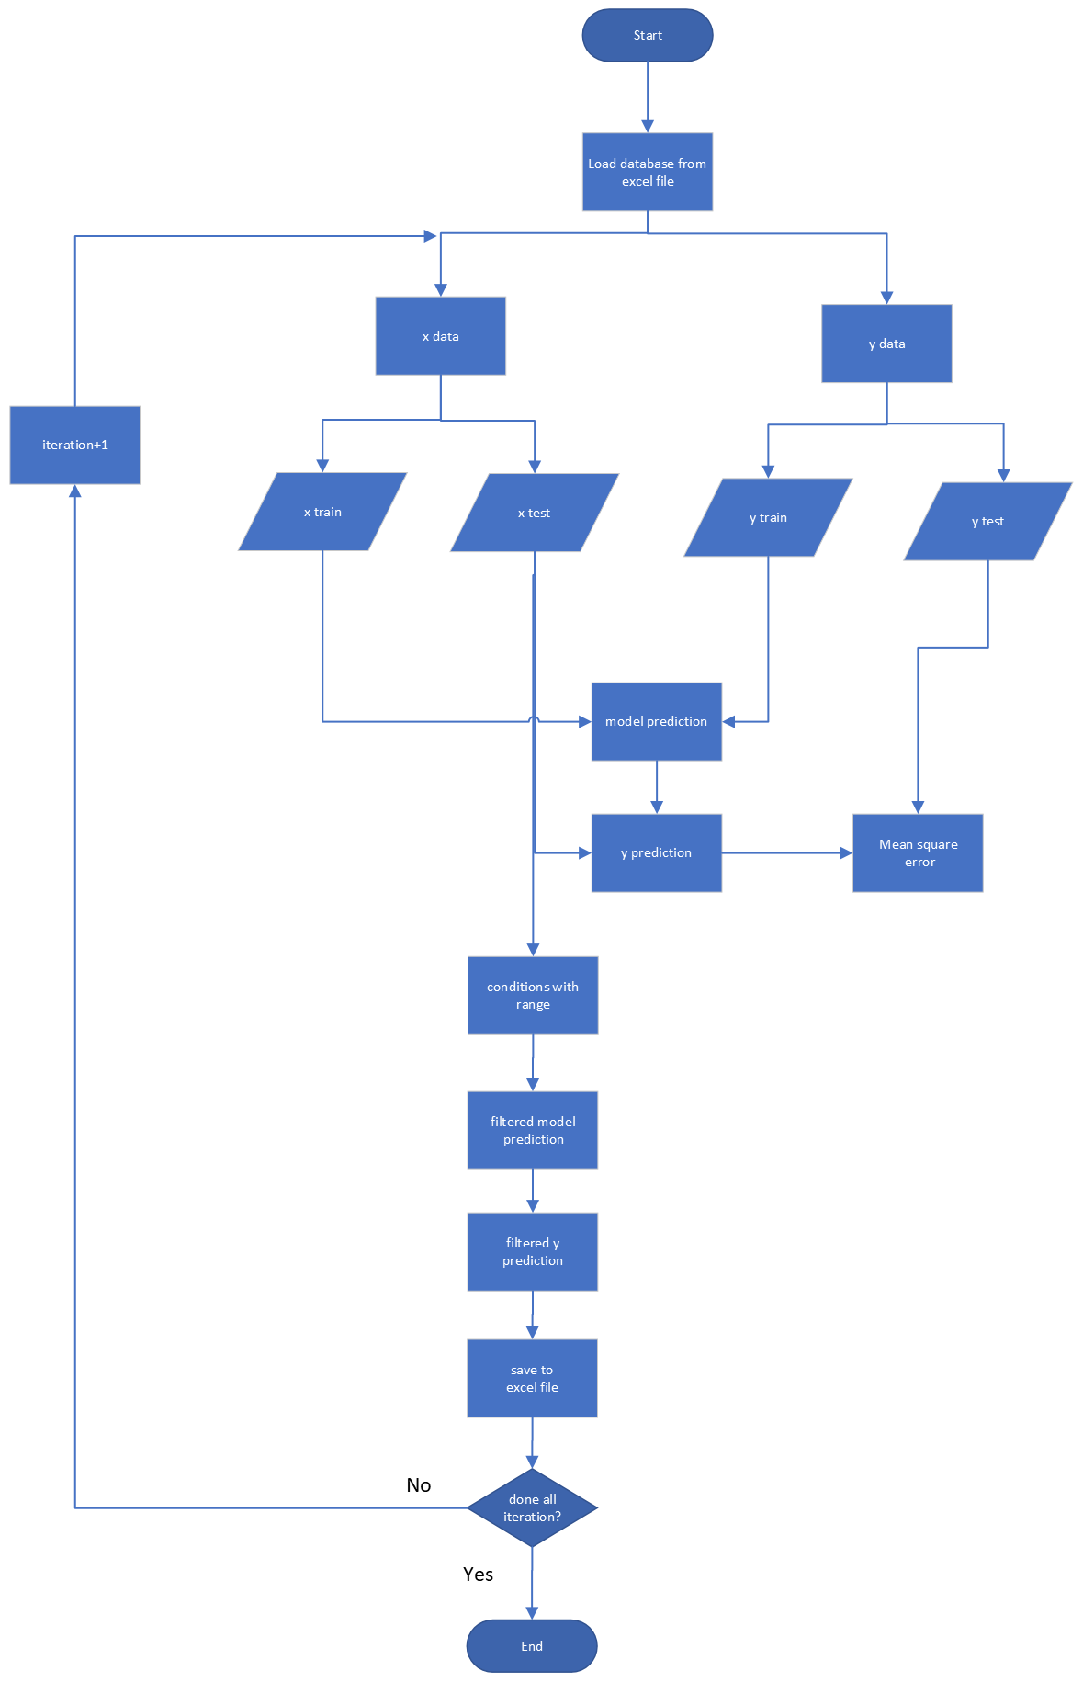
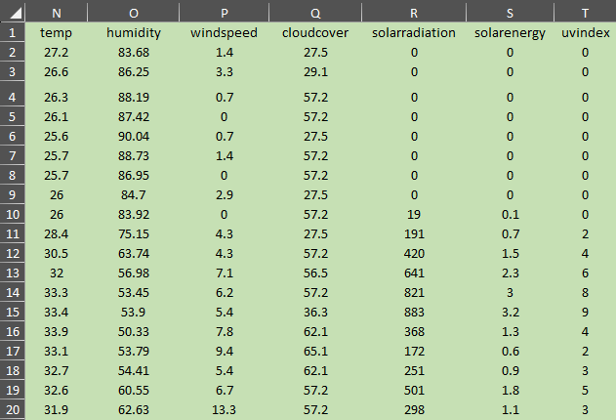

Slide 12
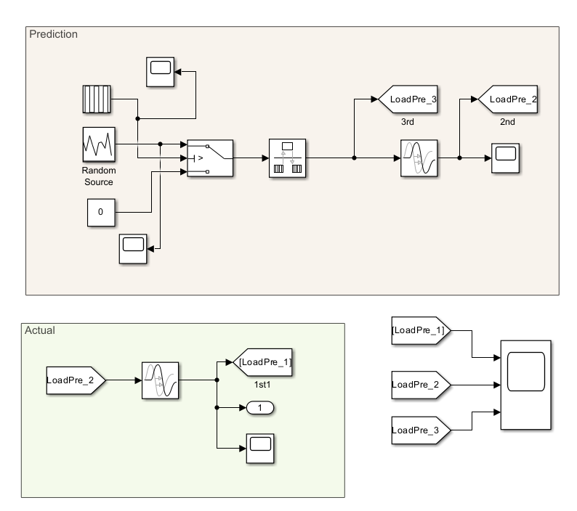
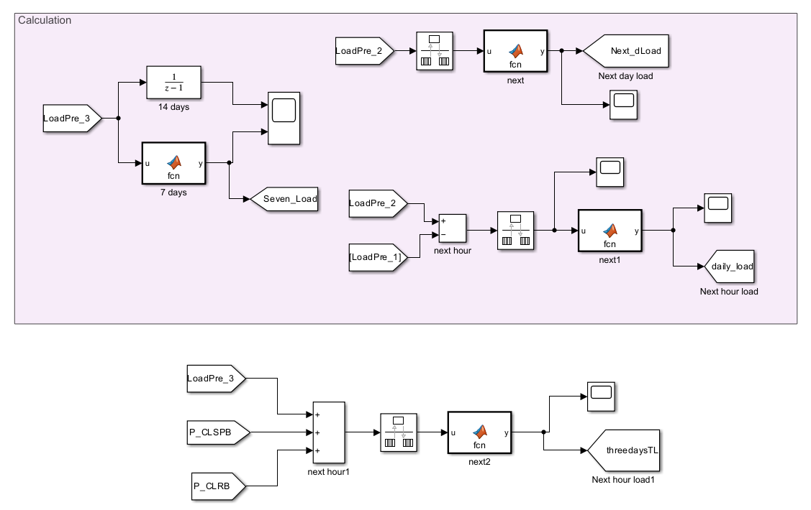

Slide 13
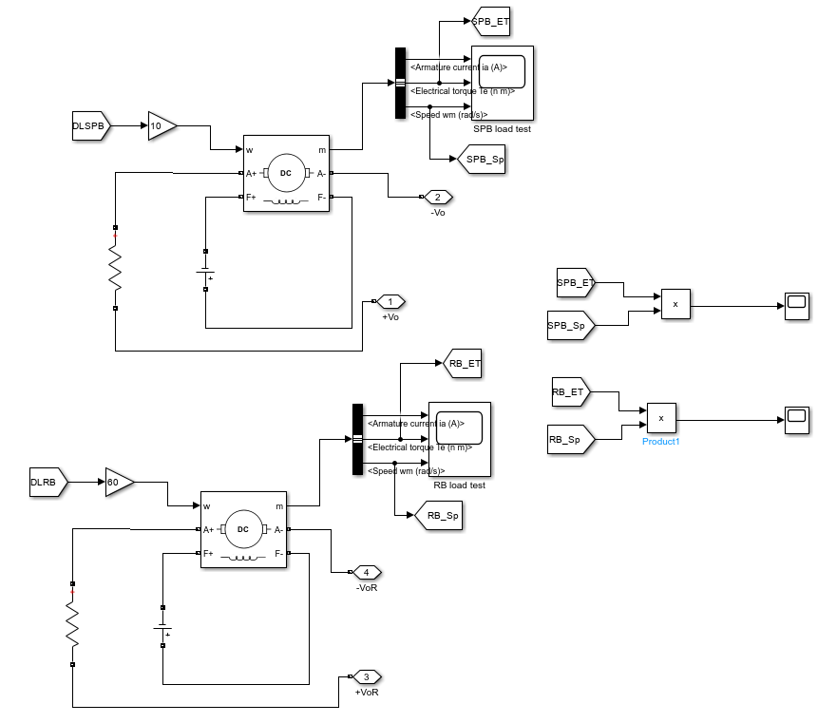
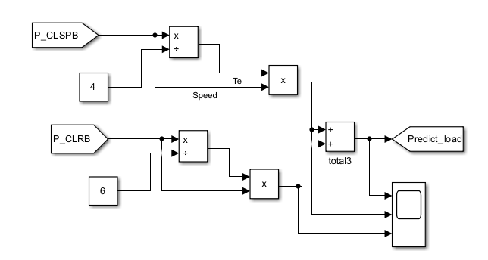

Slide 14
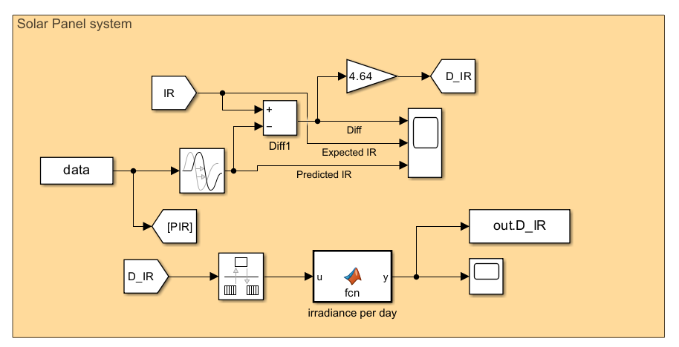
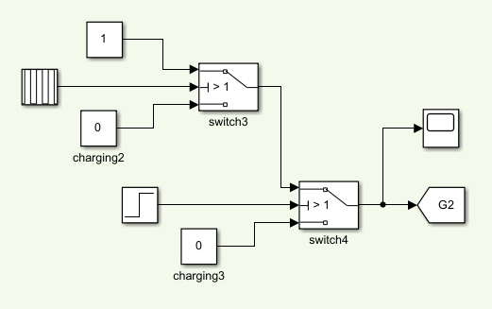
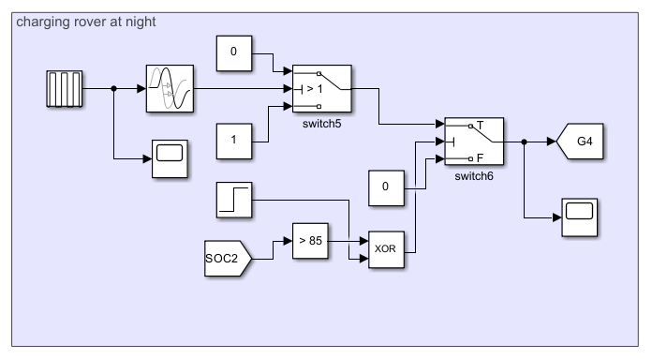
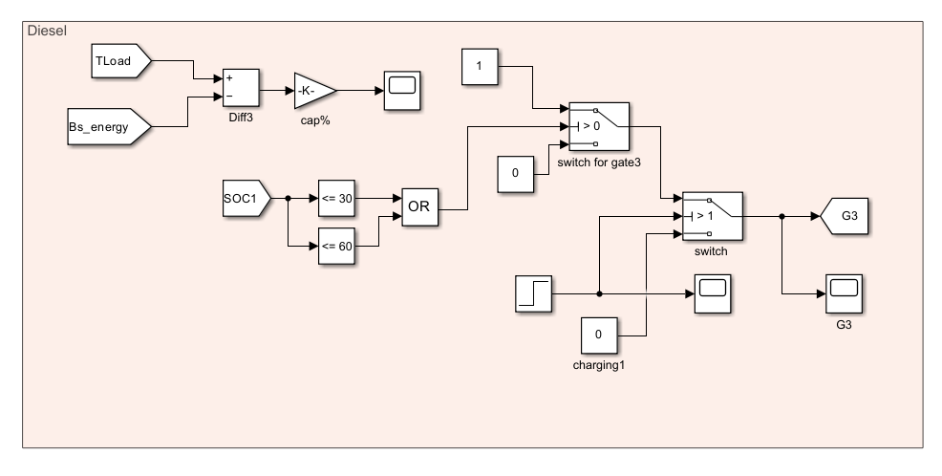

Slide 15
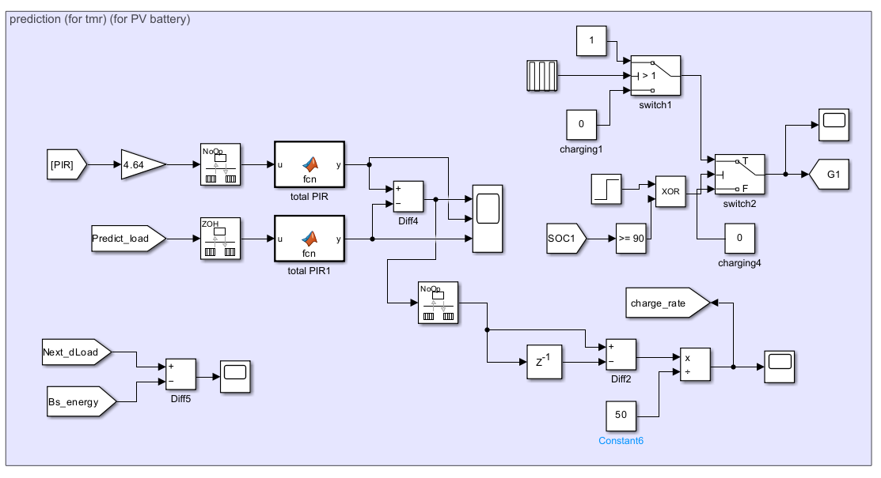
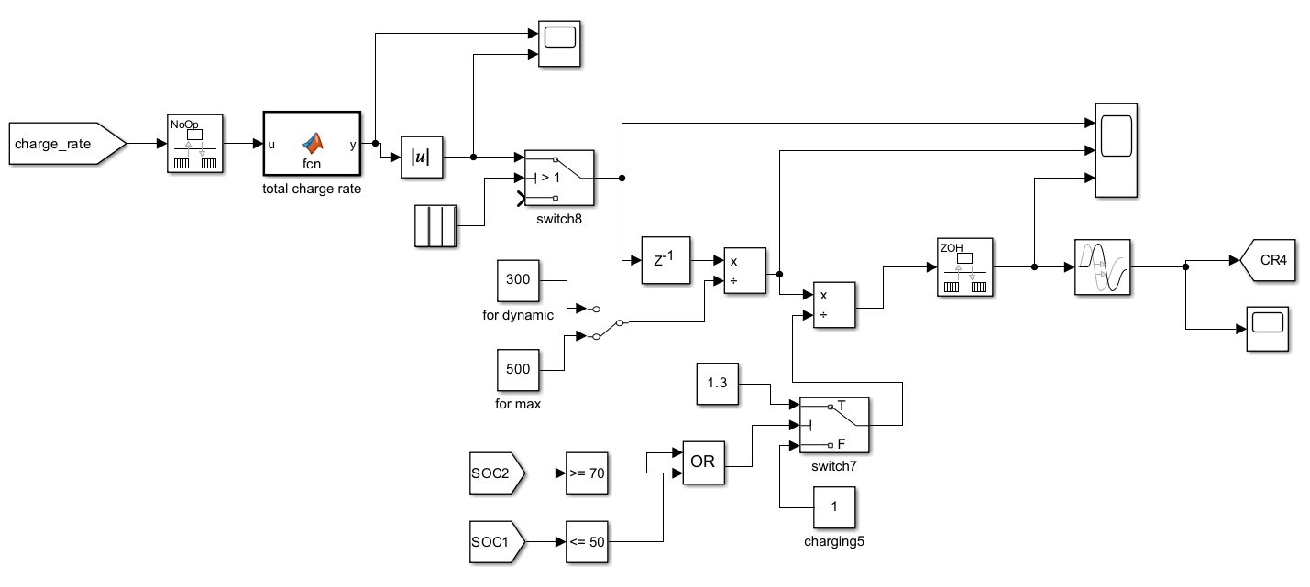

Slide 16
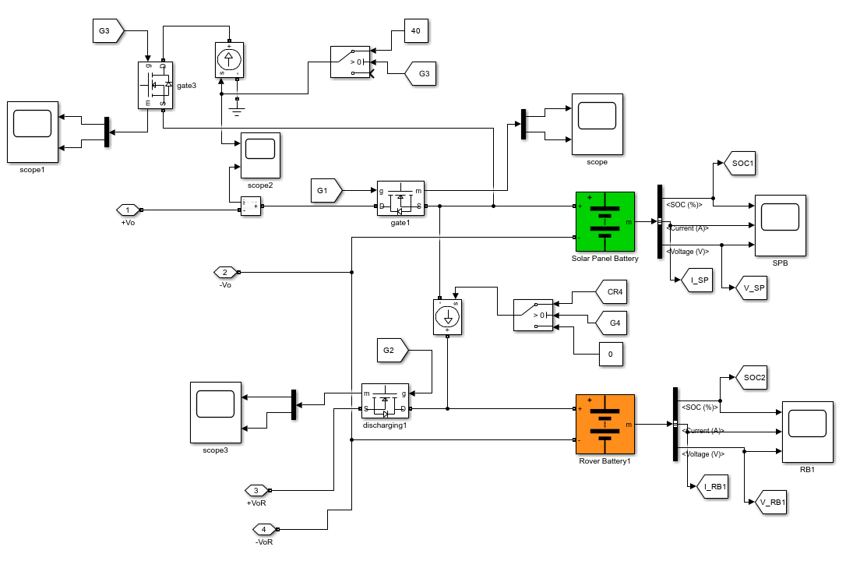

Slide 17
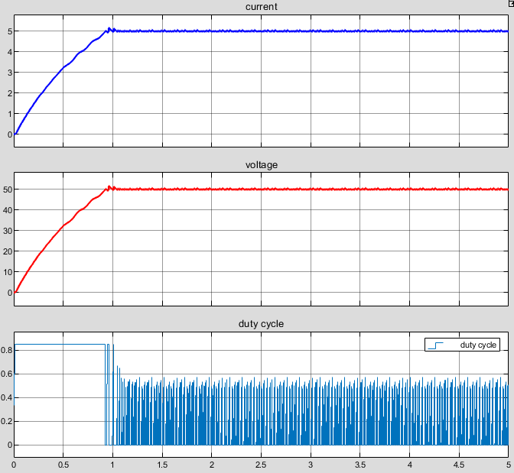
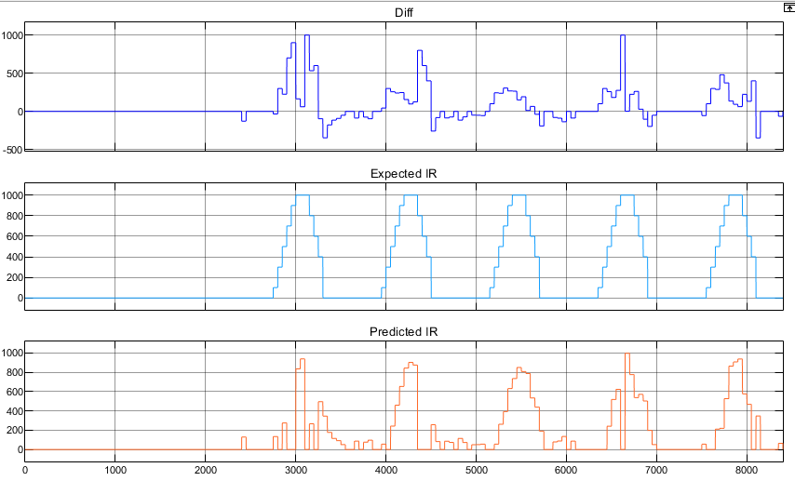
Simulink results

Slide 18
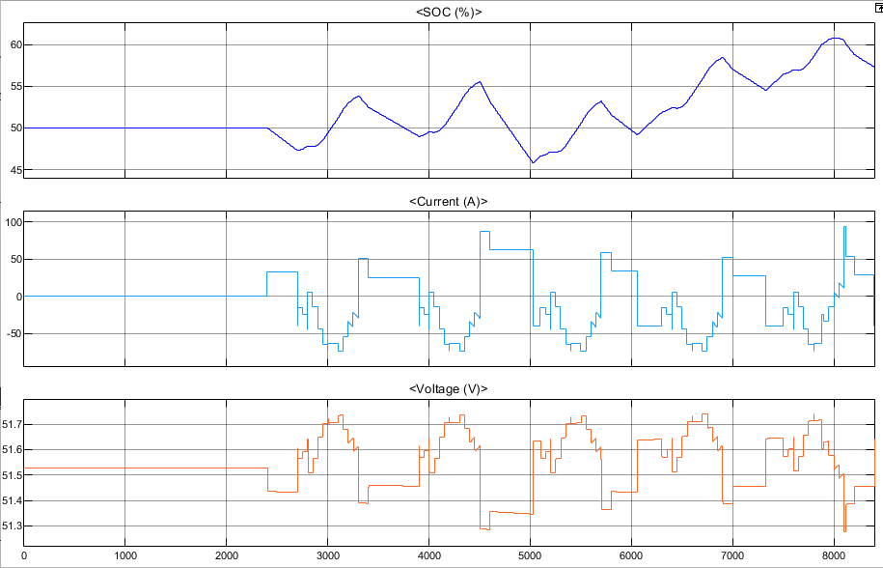
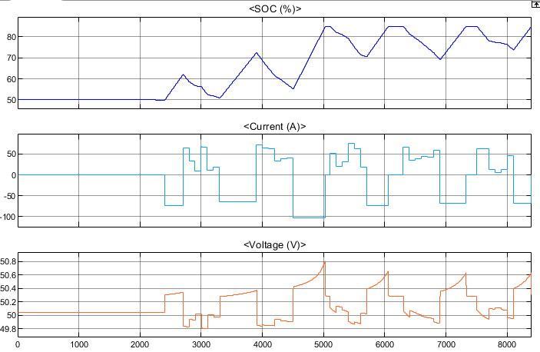

Slide 19
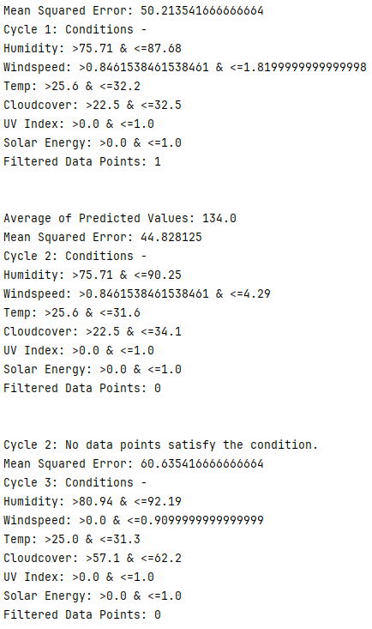
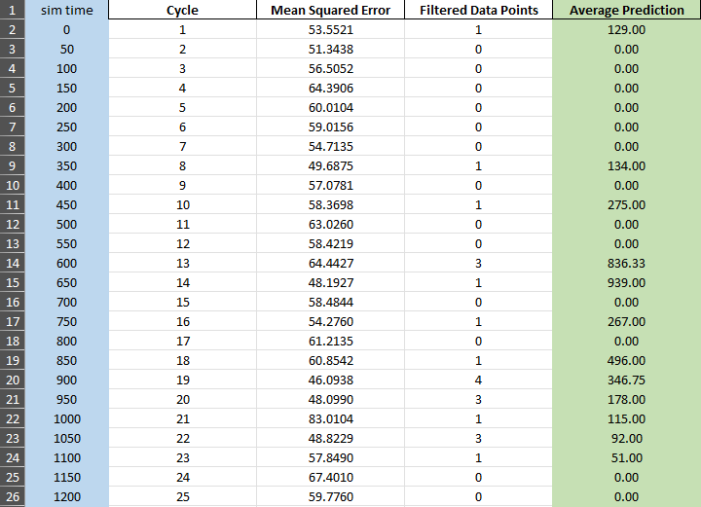
machine learning – weather prediction

Slide 20
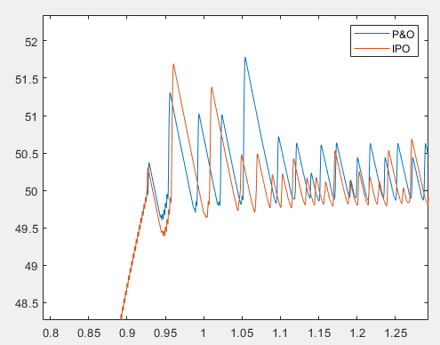
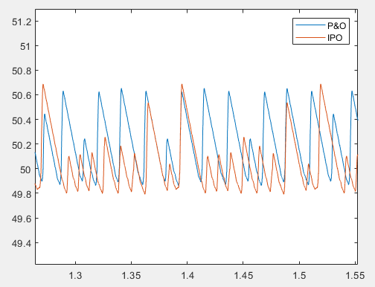
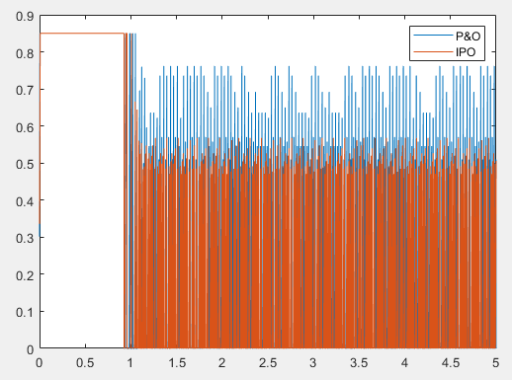

Improved P&O algorithm results and compared with conventional P&O algorithm.
Ripple effect=$40.05\%$

Slide 21
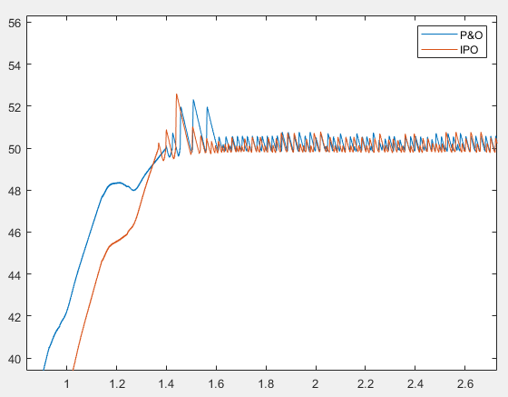
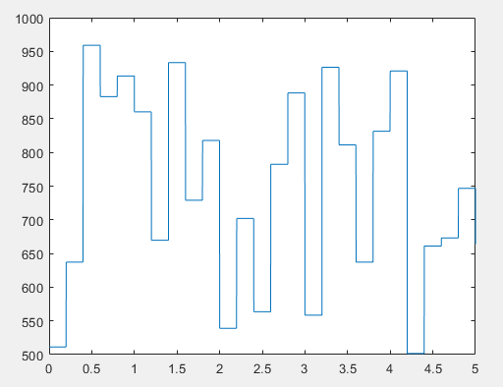
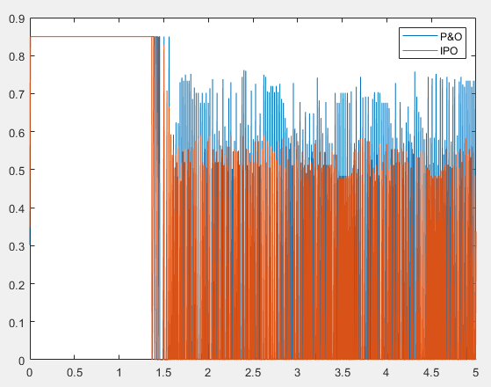
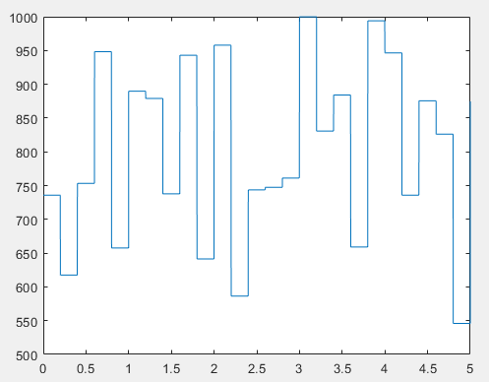
Testing on IPO algorithm with partial shading effect.

Slide 22
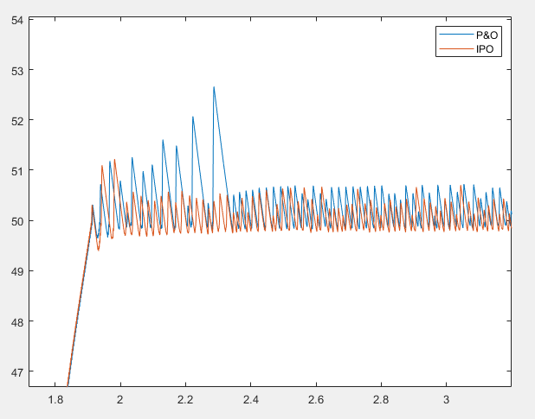
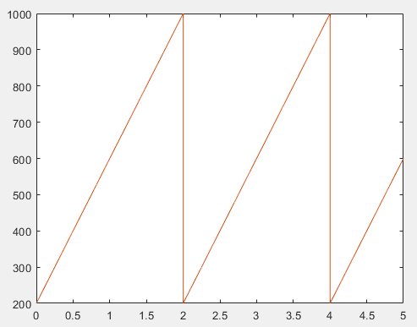

Slide 23
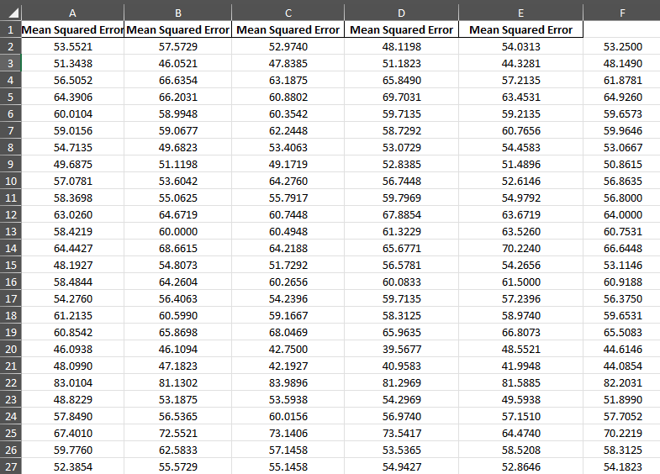
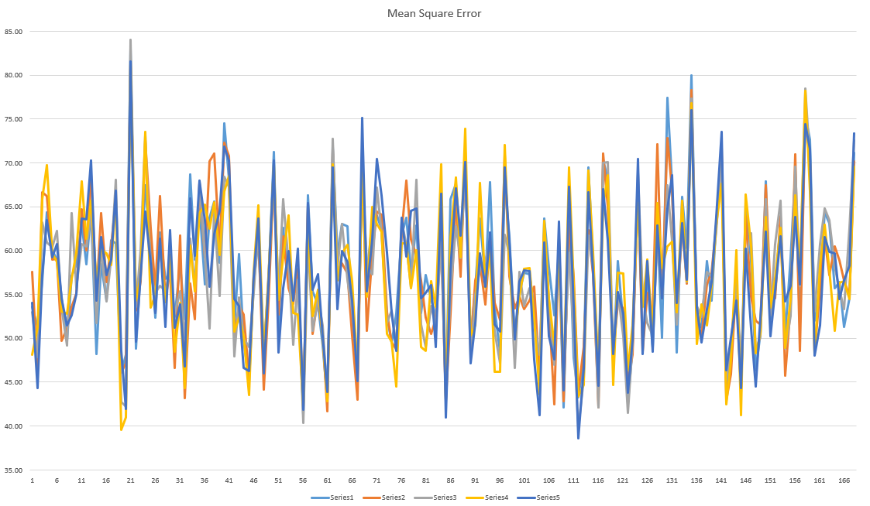
Testing on consistency and accuracy of machine learning algorithm.

Slide 24
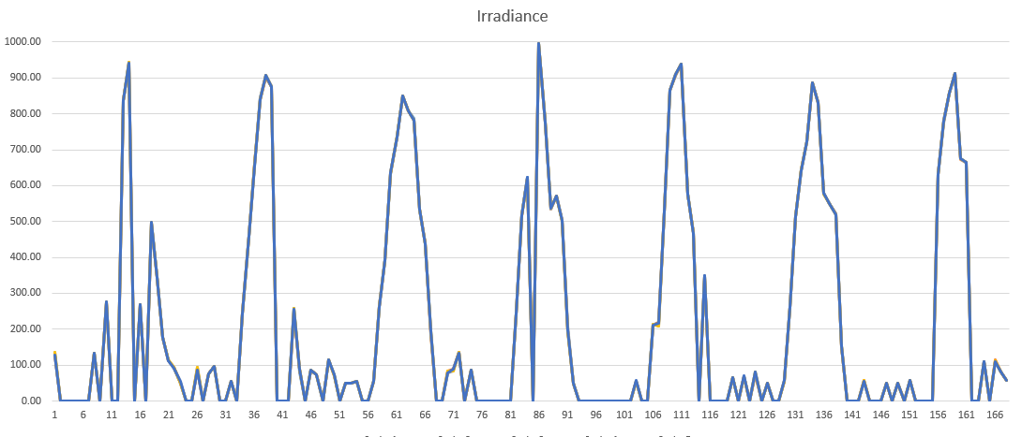


Slide 25


Testing on importance feature of machine learning algorithm.

Slide 26



Slide 27


Testing on BMS and batteries by using maximum loads.

Slide 28




Slide 29


Project management i&ii

Slide 30
conclusion
The IPO algorithm has achieved better performance in terms of steady state oscillation, duty cycle, response time and ripple effect.
Implementing machine learning for weather predictions with forecasted loads to enhance the performance of BMS.
The BMS used to control the solar panel battery and rover battery had achieved the desired output which to maintain the SOC within optimize area.
Future research
Load shifting.
Integrated with PLC, control more than two batteries.

Slide 31
references
Cao, X., & Liu, L. (2024). State-of-Charge Trajectory Planning for Low-Altitude Solar-Powered Convertible UAV by Driven Modes. Drones, 8(3), 80. https://doi.org/10.3390/drones8030080
Endi̇Z, M. S. (2023). PERFORMANCE ANALYSIS OF P&O AND PSO MPPT ALGORITHMS FOR PV SYSTEMS UNDER PARTIAL SHADING. Konya Journal of Engineering Sciences, 84–99. https://doi.org/10.36306/konjes.1359177
Faraji, J., Ketabi, A., Hashemi-Dezaki, H., Shafie-Khah, M., & Catalão, J. P. S. (2020). Optimal Day-Ahead Self-Scheduling and Operation of Prosumer Microgrids Using Hybrid Machine Learning-Based Weather and Load Forecasting. (2020). IEEE Journals & Magazine | IEEE Xplore. https://ieeexplore.ieee.org/document/9178303
Focus Malaysia. (n.d.). Phasing out coal, diesel power stations by 2023. Retrieved from https://focusmalaysia.my/phasing
Foles, A., Fialho, L., Collares-Perreira, M., & Horta, P. (2020). An approach to implement Photovoltaic Self-Consumption and Ramp-Rate Control Algorithm with a Day-to-Day. . . ResearchGate. https://www.researchgate.net/publication/347524106_An_approach_to_implement_Photovoltaic_Self-Consumption_and_Ramp-Rate_Control_Algorithm_with_a_Day-to-Day_Forecast_battery_charging_using_a_Vanadium_Redox_Flow_Battery?enrichId=rgreq-ddb82b3d8befb1f87781de436c0f5d6a-XXX&enrichSource=Y292ZXJQYWdlOzM0NzUyNDEwNjtBUzoxMDA2NzIyNjk3MTUwNDY1QDE2MTcwMzI4MDM3MjA%3D&el=1_x_3&_esc=publicationCoverPdf
Isknan, I., Asbayou, A., Aamoume, A., Ihlal, A., & Bouhouch, L. (2022). A comparison of various P&O algorithms in order to track the MPPT of a solar panel. *International Journal of Power Electronics and Drive Systems, 13*(4), 2457-2467. https://doi.org/10.11591/ijpeds.v13.i4.pp2457-2467
Katche, M. L., Makokha, A. B., Zachary, S. O., & Adaramola, M. S. (2023). A comprehensive review of maximum power point tracking (MPPT) techniques used in solar PV systems. Energies, 16(5), 2206. https://doi.org/10.3390/en16052206²
LAWS OF MALAYSIA Act 447 ELECTRICITY SUPPLY ACT 1990. (2016). https://www.st.gov.my/contents/2020/AKTA/Electric/Act%20447%20%20Electricity%20Supply%20Act%201990.pdf

Slide 32
demonstration

Slide 33
Q&a section

Slide 34
Thank you

